Slide 1
Correlations Between USAID Contributions and Outcomes in the Sub-Saharan African Region
Completed in Partial Fulfillment of the MAy 2019 UMN Data Visualization and Analytics Bootcamp Program
By Julia Sweet, Ricardo Bonner, Venkata Priyanka Sagi, Eddie Freier, Wondwossen Abatheneh, and Kingsford Brown Dadzie

Slide 2
Guiding Questions
Our overarching question was: “Does USAID accomplish its mission through aid in Sub-Saharan Africa?” We looked more specifically at:
Is aid in Sub-Saharan African countries correlated with improved political stability?
Is aid in Sub-Saharan African countries correlated with increased GDP?
Is aid in Sub-Saharan African countries correlated with reduced infant mortality?
Is aid in Sub-Saharan African countries correlated with population?
Notes:
The United States Agency for International Development (USAID)’s mission is “to advance a free, peaceful, and prosperous world.” Its goals include poverty reduction, strengthening of democratic governance, decreased mortality, and enabling aid recipients to progress beyond assistance. Foreign aid currently comprises less than 1% of the federal budget

Slide 3
Data Sources and Data Cleaning
We drew from two primary sources for our project: USAID and the World Bank.
wbpy API – World Bank PY: Stability Rate, Infant mortality, Population and GDP
USAID: Economic and Military funding from 2002 – 2017

Slide 4
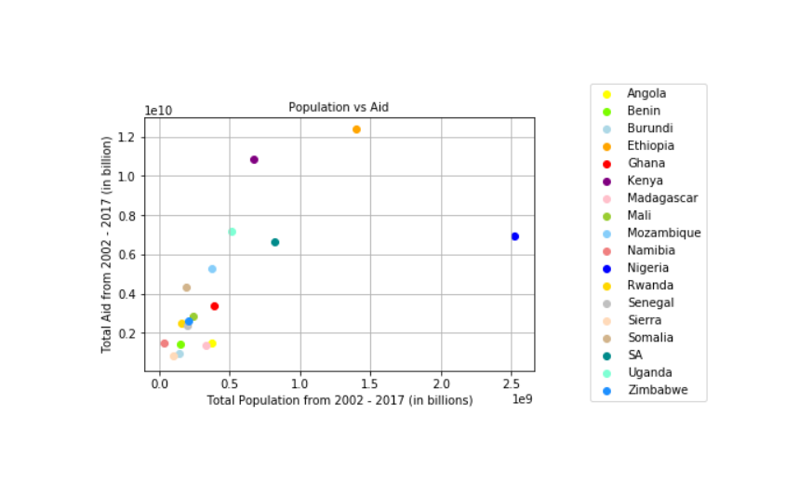
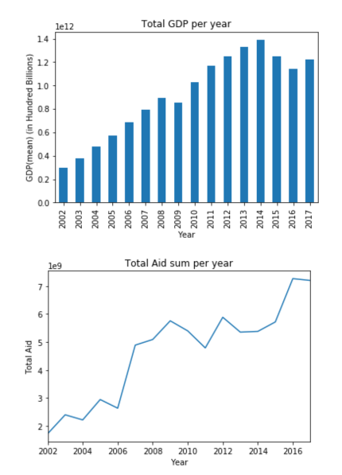
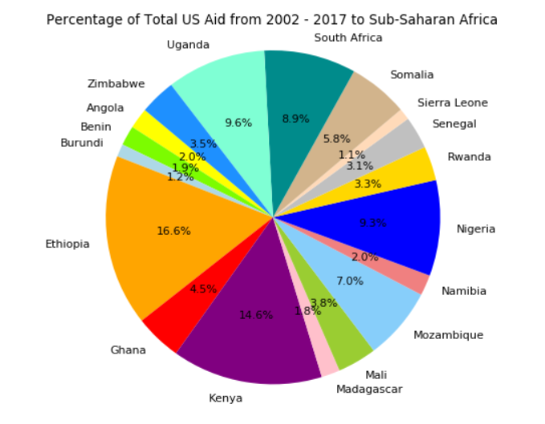
Descriptive graphs

Slide 5
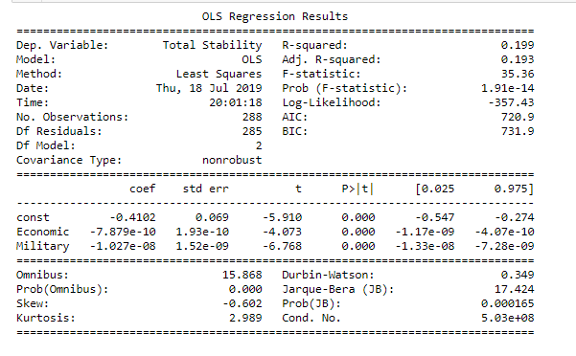
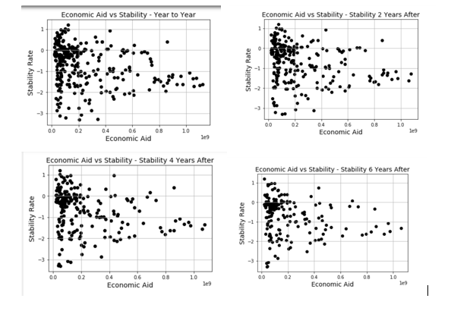
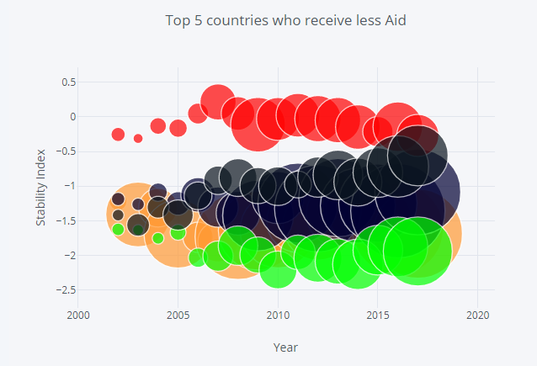
Aid vs stability – No Correlation
Notes:
Looking at the stats for Aid vs Stability, we conclude that USAID has not effect on the stability rate for the countries that are funded.

Slide 6
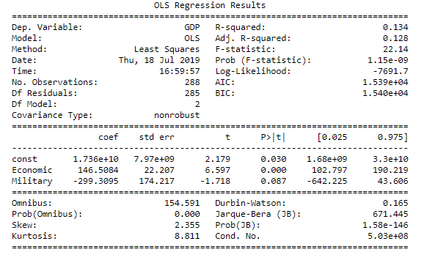
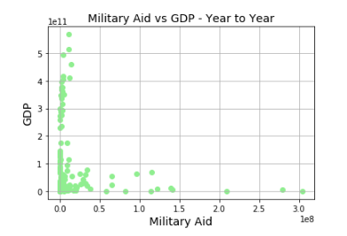
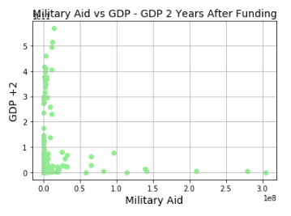
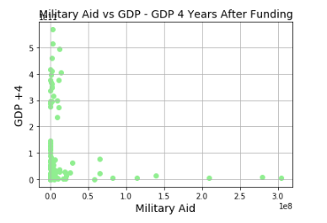
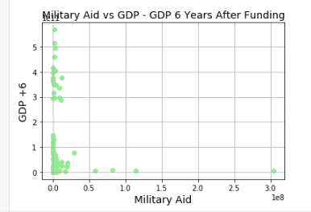
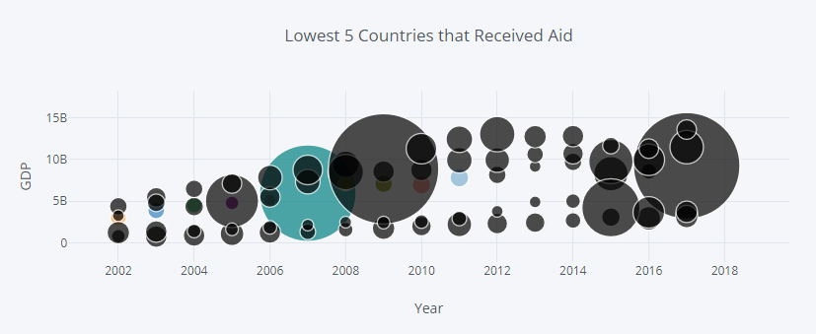
Aid vs GDP – No Correlation
Notes:
Looking at the statistics there is no correlation between Aid and GDP. This shows that USAID does not have any effect on improving countries GDP.

Slide 7
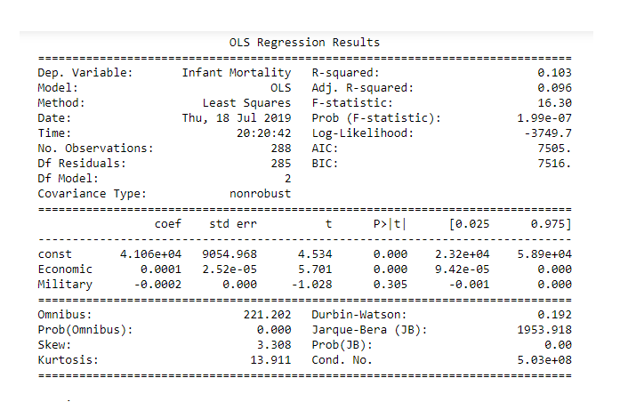
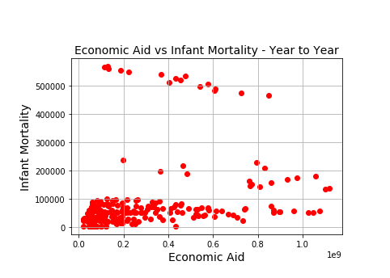
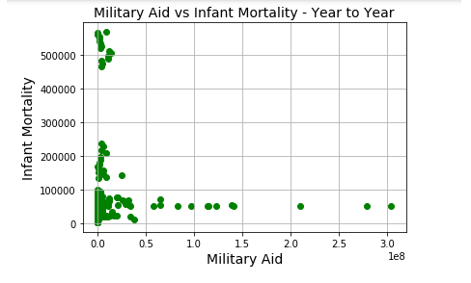
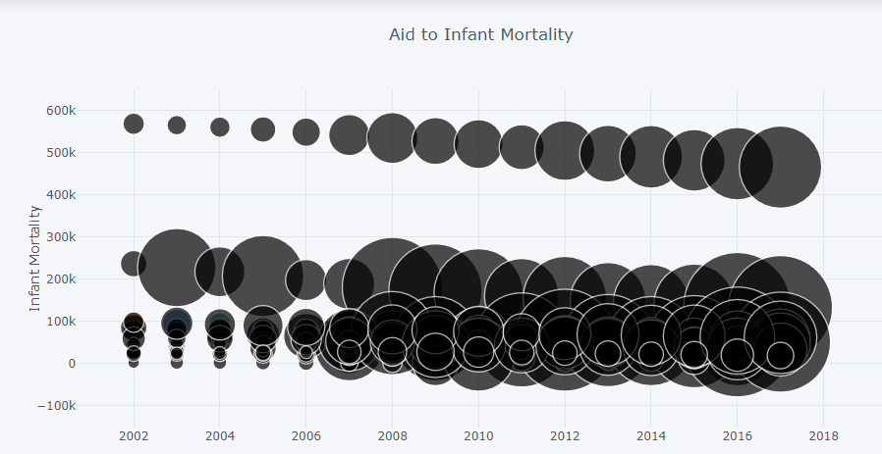
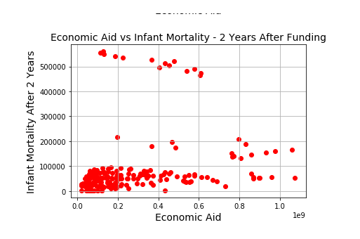
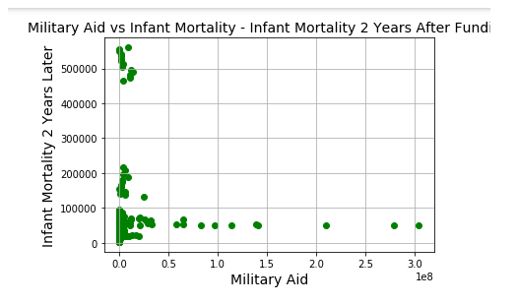
Aid vs infant mortality
Notes:
Looking at the statistics there is no correlation between Aid and Infant Mortality. This shows that USAID does not have any effect on improving it.

Slide 8
Conclusion
Conclusions:
1) Does US aid contribute or even has any correlation with Stability in the region and contribute to a safer world?
Ans: Our analysis says “Most likely NO!” There is very little evidence to show a correlation between aid and stability. There was also very little evidence of correlation between aid and the other variables investigated.
2) So, what is the US getting out of its aid contribution to SSA?
An interesting question for investigation will be “Even though it does not have strong correlation with stability in SSA, does US aid contribute to stability/security in the US by containing the spillovers of instability in those countries themselves? In short: could aid be a means of keeping the trait for US arising from finding its way to home? “Containment”
3) Issues that might have had implications for our analysis could include:
Our case investigated only the correlation between US aid and stability rather than the total aid package those countries obtained from all sources- Beside from the US, those countries receive bilateral and multilateral aid from a variety of other sources.

